Slide 1
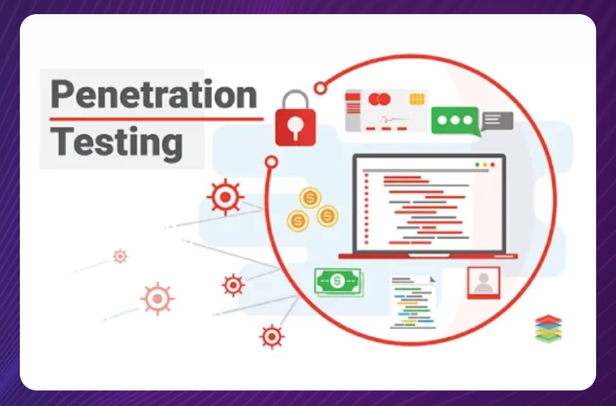
Presented by
Professor Dr. Mohammed Shafiul Alam Khan
IIT, DU

Slide 2
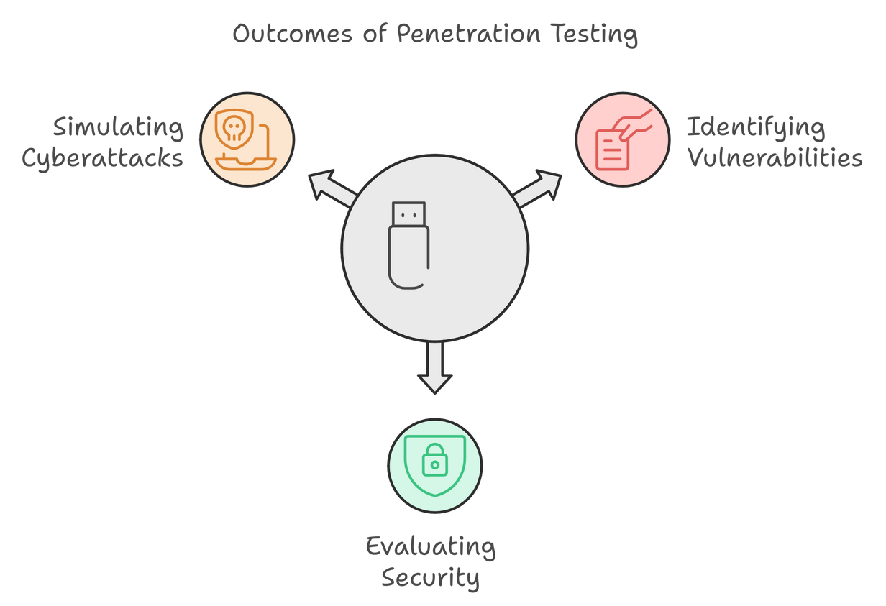
Penetration Testing / Ethical Hacking
A proactive cybersecurity practice
A simulated cyberattack performed to evaluate the security of a system, network, or application by identifying vulnerabilities that could be exploited.
Purpose
Assess system security, identify weak points, prevent real attacks
To strengthen security measures
Assessing Compliance

Slide 3
PEN TESTING
Common Terminologies
Vulnerability: A weakness in a system that attackers can exploit to compromise security.
Exploit: A method or code used to take advantage of a vulnerability in a system.
Payload: The part of an exploit that performs the malicious action once the system is compromised.
Privilege Escalation: Gaining unauthorized higher-level access to a system.
Attack Vector: The path or method used to exploit a vulnerability (e.g., phishing).
Zero-Day: A newly discovered vulnerability without a vendor patch available.
Post-Exploitation: Actions taken after exploiting a system, like data extraction or maintaining access.

Slide 4
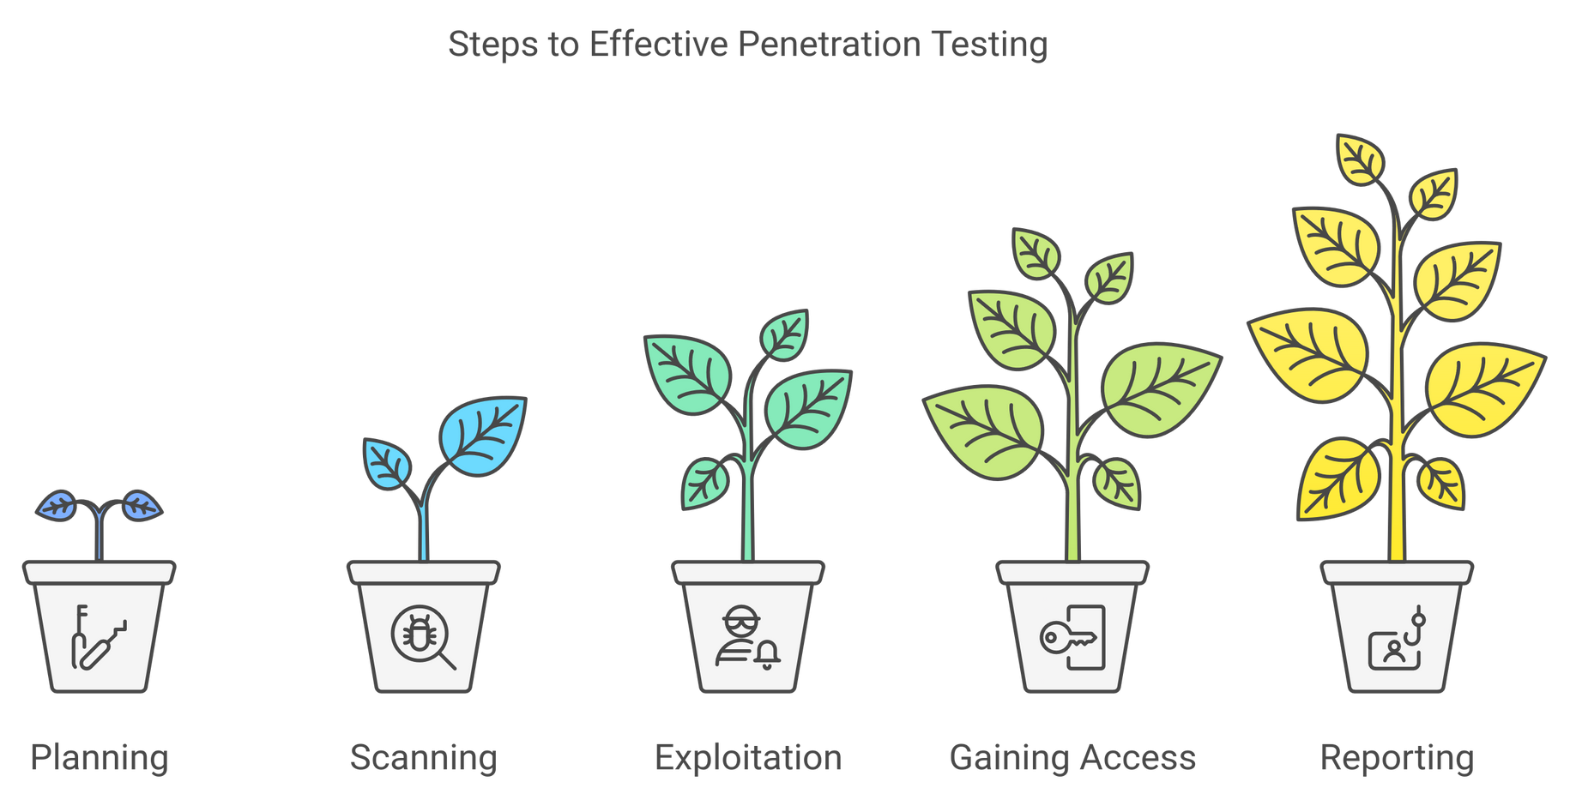
PEN TESTING
How it Works

Slide 5
PEN TESTING
Steps
Reconnaissance (Plan): Gather information about the target system using open-source intelligence and other techniques
Scan: Scanning phase involves actively probing the system for vulnerabilities using automated tools and manual techniques
Exploit: Attempt to exploit vulnerabilities in a controlled manner to assess the impact of a potential attack. It mimics the tactics used by real attackers to gain unauthorized access, escalate privileges, exfiltrate data, or disrupt operations.
Report: Analyze findings and compile a comprehensive report that outlines the identified security weaknesses, their potential impact, and recommended remediation measures which is used to patch vulnerabilities, improve security policies, and enhance defense mechanisms.

Slide 6
Start by defining the aim and scope of a test.
To better understand the target, one should understand how it functions and any possible weaknesses.
Locate vulnerabilities in the target application using pen-testing strategies, i.e. cross-site scripting and SQL injection.
Exploited vulnerabilities
Sensitive data accessed
Plan
Scan
Gain Access
Maintain Access
Analyse
Use static or dynamic analysis to scan the network.
Inform pen-testers regarding the application responds to various threats.
Check the ability of a cybercriminal to maintain a persistent presence through an exploited vulnerability

Slide 7
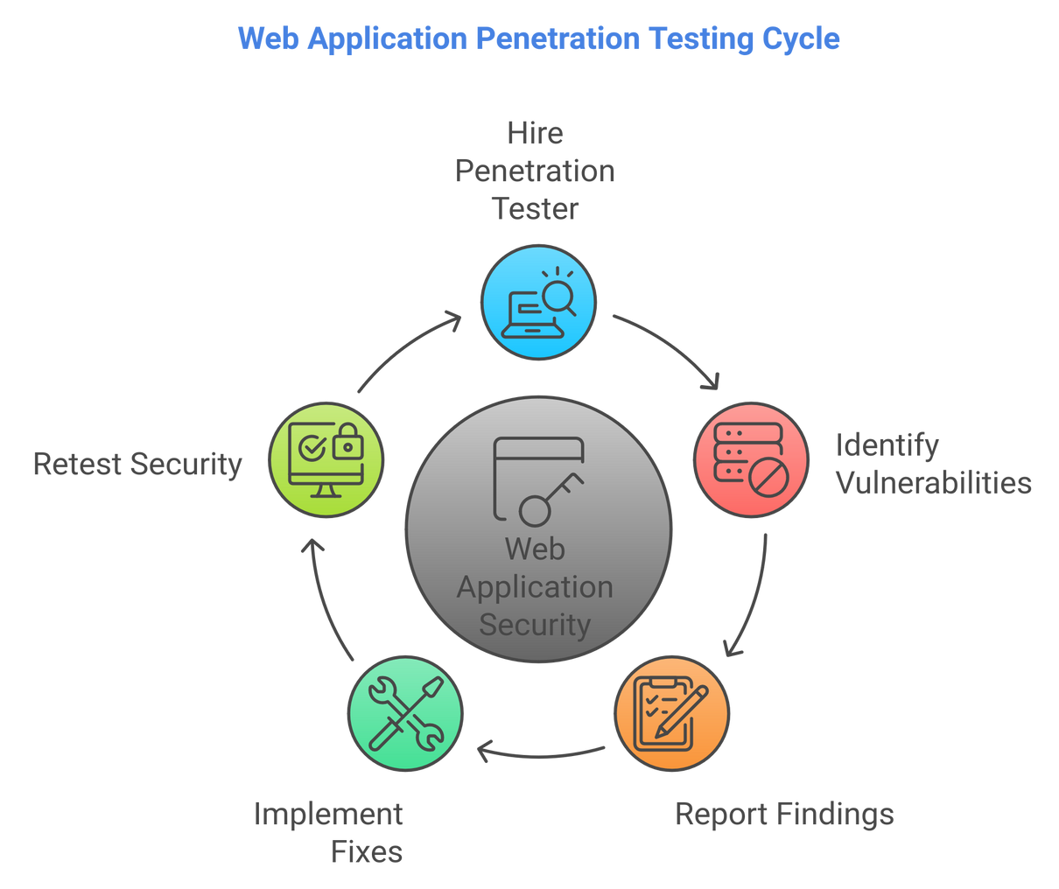
PEN TESTING
Example
A company has an e-commerce website and wants to ensure it’s secure from potential cyberattacks. They hire a penetration tester to assess its vulnerabilities.

Slide 8
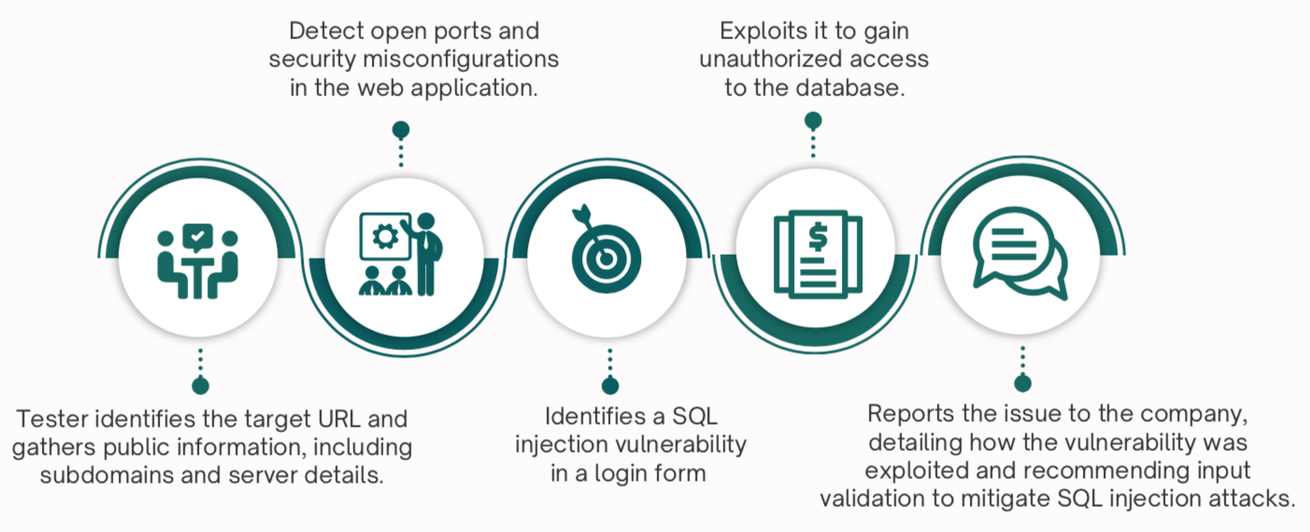
PEN TESTING
Example

Slide 9
PEN TESTING
Types of Pen Testing
Black Box Testing:
Tester has no prior knowledge of the system.
Mimics an external attack.
White Box Testing:
Tester has full knowledge of the system (e.g., source code, architecture).
Mimics an internal attack.
Grey Box Testing:
Partial knowledge of the system.
Simulates an insider threat with limited access.

Slide 10
PEN TESTING
Issues Addressed
Uncovered Vulnerabilities: Identifying hidden flaws in systems, applications, or networks
Misconfigurations: Misconfigured security settings that expose systems to unauthorized access or attacks.
Outdated Systems and Software: Older software or systems that lack the latest security patches
Human Errors: Errors by users or administrators that inadvertently create security risks.
Lack of Real-World Attack Simulation: Organizations often struggle to understand how an attacker could exploit their systems.
Non-Compliance with Security Standards: Organizations may not meet regulatory requirements for security testing.

Slide 11
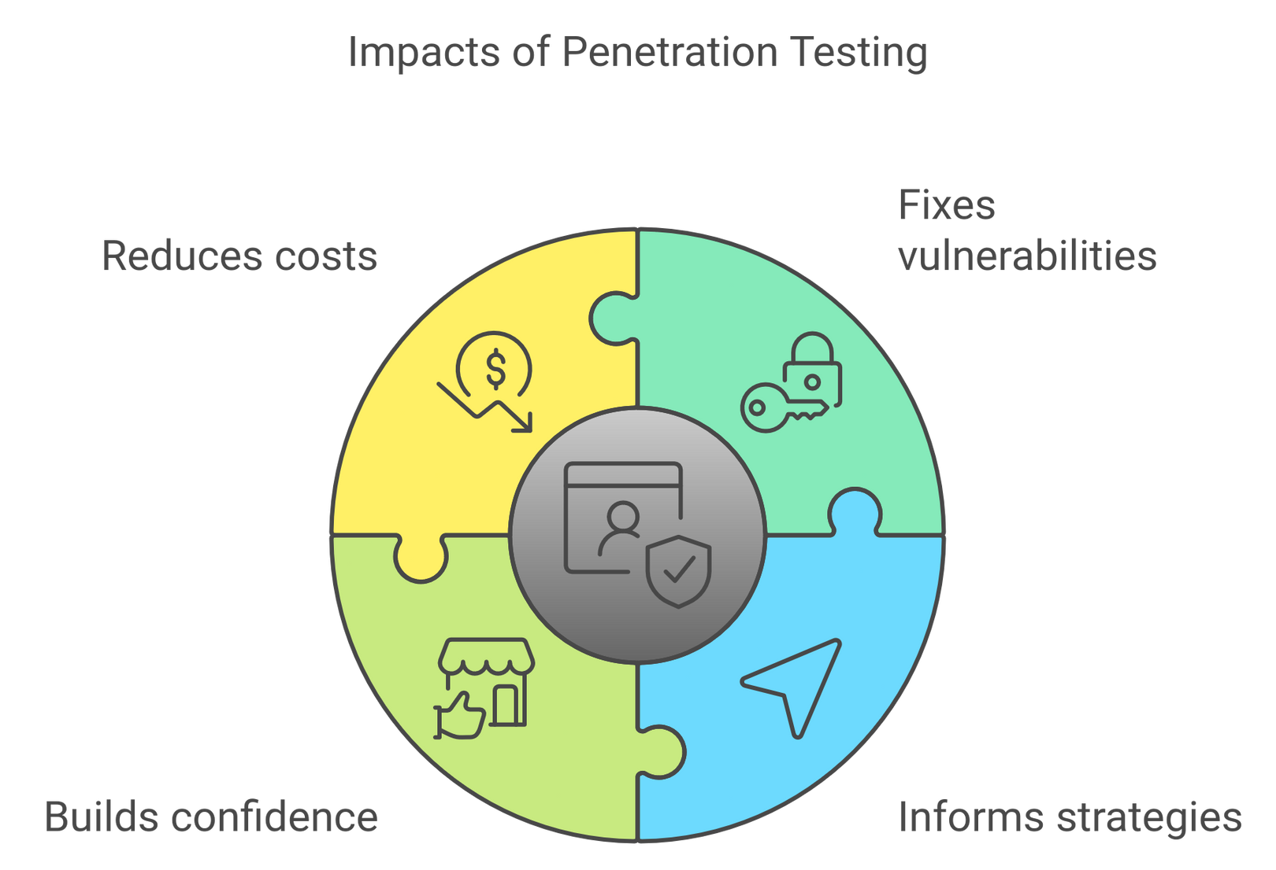
PEN TESTING
Impacts on Security
Proactive Risk Mitigation
Strengthened Regulatory Compliance
Boosted Security Awareness
Better Security Posture
Reduced Financial and Reputational Risk
Builds Customer’s Trust and Assurance

Slide 12
PEN TESTING
Common Challenges
Scope Creep: Uncontrolled growth of scope
Lack of Communication and Collaboration
Limited time and resources
False Positives and Negatives
Evolving Threat Landscape
Resistance from IT Teams

Slide 13
PEN TESTING
Common Cyber Attacks
Phishing: Deceptive emails or messages designed to trick individuals into revealing sensitive information like passwords or credit card numbers.
Denial of Service (DoS): Overloading a system, network, or website with traffic to make it unavailable to users.
Man-in-the-Middle (MITM): Intercepting and altering communications between two parties without their knowledge.
Ransomware: Malware that encrypts a victim’s data and demands payment for its release.

Slide 14
PEN TESTING
Common Web Attacks
SQL Injection: Exploiting input fields to inject malicious SQL queries, enabling unauthorized database access or manipulation.
XSS (Cross-Site Scripting): Injecting malicious scripts into web pages viewed by users, leading to data theft or session hijacking.
Broken Authentication: Flaws in authentication processes that allow attackers to compromise user credentials or sessions.
Security Misconfiguration: Improperly configured security settings that expose systems to potential attacks.
Cross-Side Request Forgery (CSRF): Exploit to make malicious requests to internal or external resources.

Slide 15
PEN TESTING
Common Network Attacks
Port Scanning: Probing a network to discover open ports and identify running services for potential exploitation.
Eavesdropping: Intercepting network communications to capture sensitive data like passwords or messages.
Packet Sniffing: Capturing and analyzing network traffic to gather information or exploit vulnerabilities.
Replay Attacks: Capturing and reusing legitimate network data (e.g., authentication tokens) to gain unauthorized access.
IP Spoofing: Faking an IP address to impersonate a trusted system and bypass security measures.
DNS Poisoning: Manipulating DNS records to redirect users to malicious websites or intercept traffic.

Slide 16
PEN TESTING
Common Tools
Relies on a variety of tools to identify, exploit, and assess security vulnerabilities.
Reconnaissance
Shodan
Vulnerability Scanners
Nmap (network scanning tool)
Exploitation Frameworks
Metasploit (comprehensive database of known exploits)
SQLmap (SQL injection vulnerabilities)
Nessus and OpenVAS (explore security weaknesses, misconfigurations, and outdated software versions)
Harvester
Maltego (extract publicly available data, such as domain names, email addresses, IP addresses, and subdomains.

Slide 17
PEN TESTING
Common Tools
Password Attack Tools
John the Ripper
Post-exploitation Tools
Mimikatz
Web Vulnerability Scanners
Burp Suite,
Hashcat
Hydra
Empire
OWASP ZAP

Slide 18
PEN TESTING
Common Tools
Network Tools
Wireshark
Mobile Testing Tools
MobSF
Aircrack-ng
Drozer

Slide 19
PEN TESTING
Common Industry Certifications
CompTIA PenTest+
CEH (Certified Ethical Hacker)
OSCP (Offensive Security Certified Professional)
GIAC GPEN (Certified Penetration Tester)
OSWE (Offensive Security Web Expert)
GXPN (GIAC Exploit Researcher and Advanced Penetration Tester)

Slide 20

THANK YOU!

